Slide 1
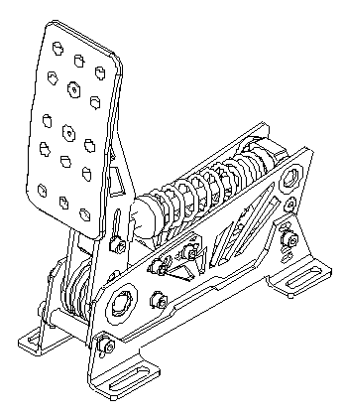
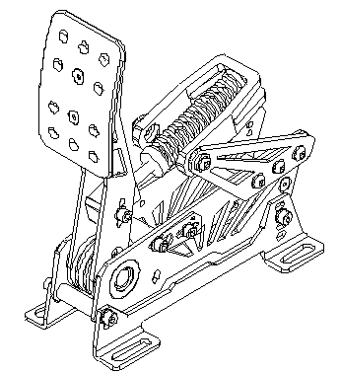
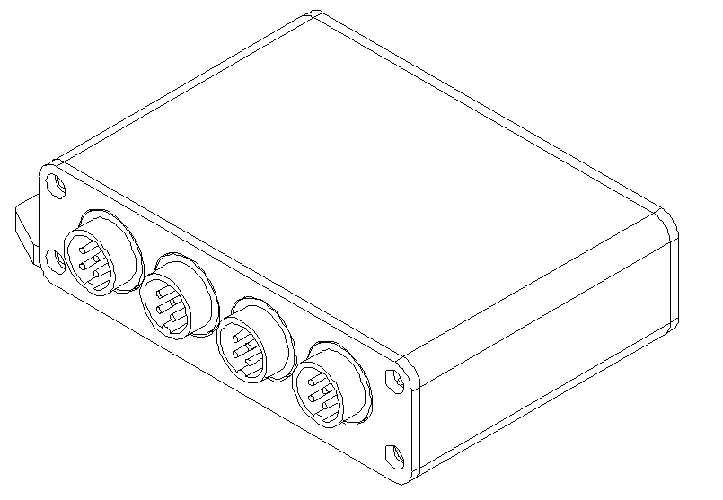
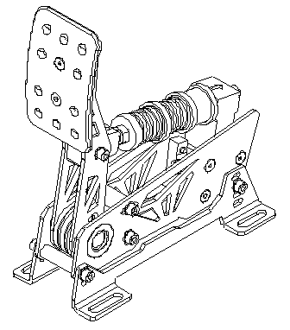
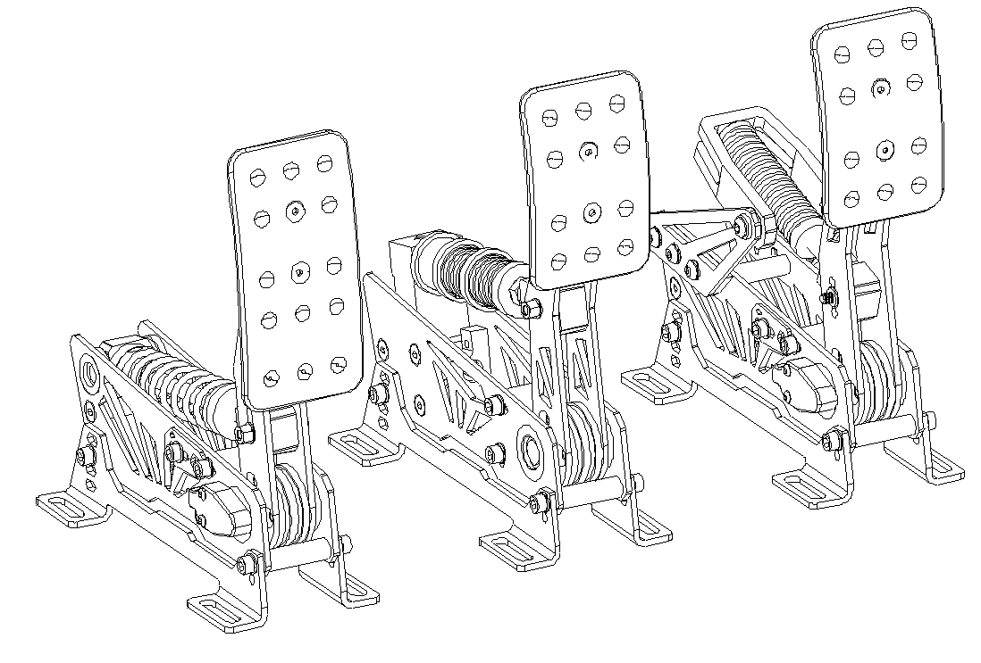
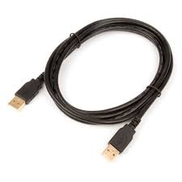
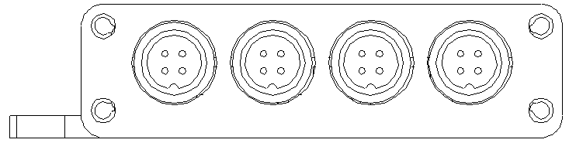
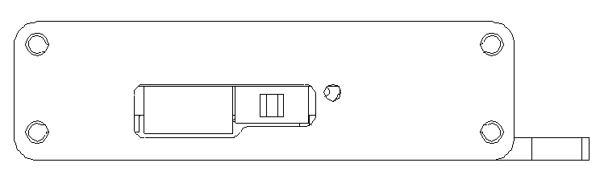
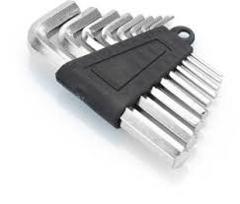

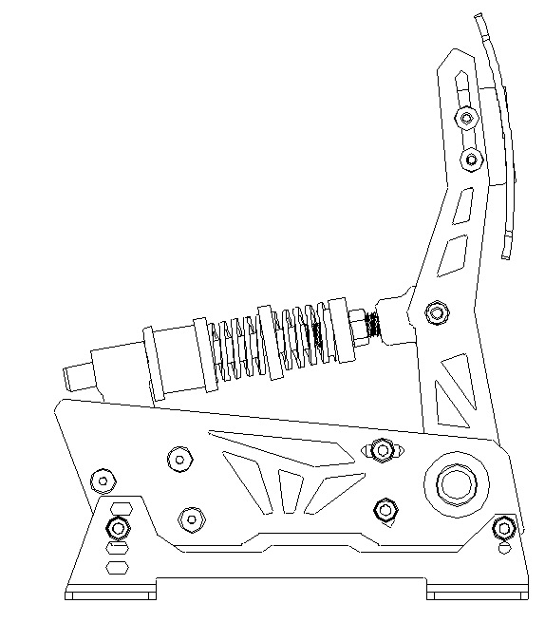
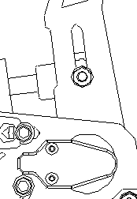
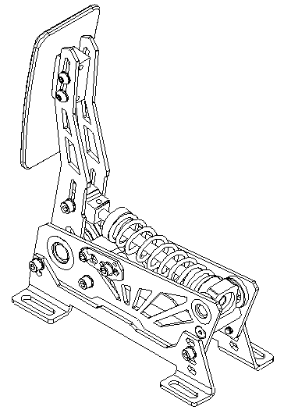
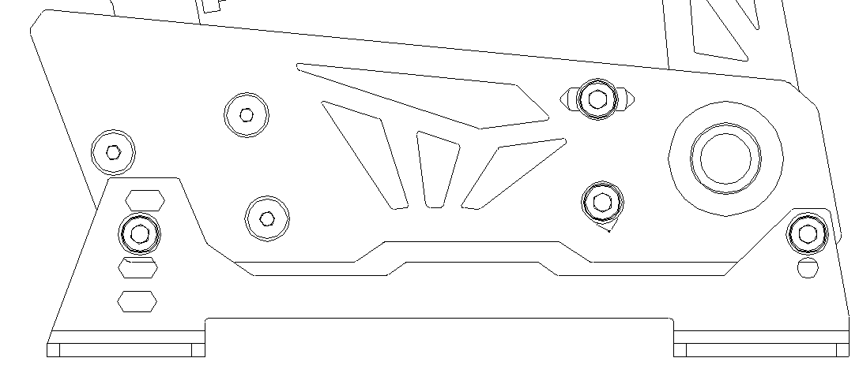
VNM PEDALS LITE
Quick Guide
Box Includes
Connection
1
2
3
4
1
Left side: GX12 Ports for:
1. Handbrake 3. Brake
2. Throttle 4. Clutch
Plug each pedal in its corresponding port
2
5
3
1. VNM Throttle
2. VNM Brake
3. VNM Clutch (*)
4. VNM Controller Box
5. USB Cable
6. Allen key set & Mounting screws
7. Red & Yellow springs
Right side:
5. DFU/RUN Mode Switch
Up: DFU Mode
Down: RUN Mode
6. USB Port for PC connection
6
5
4
6
7
(*) Not included with VNM Lite Pedal set 2
Pedal Adjustment
1. Adjust the height of the Pedal face
2. Adjust the Pedal tilt angle
3. Adjust the Pedal Stiffness
Loosen the 4 the hex bolts on the sides behind the pedal face, choose a suitable pedal height, then tighten.
2 height levels at the front and 4 height levels at the back allow multiple tilt angle options
Remove the 2 hex bolts on each side, tilt the pedal to a suitable angle, insert the bolts back into place and tighten them with the hex bolts.
Twist the spring preload cap clockwise for a stiffer pedal actuation
Or anti-clockwise for a softer pedal actuation
Move the pivot point of the spring assembly up/down for a stiffer/softer pedal actuation
3
4
1
5
2
6

Slide 2
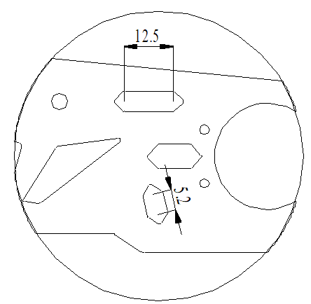
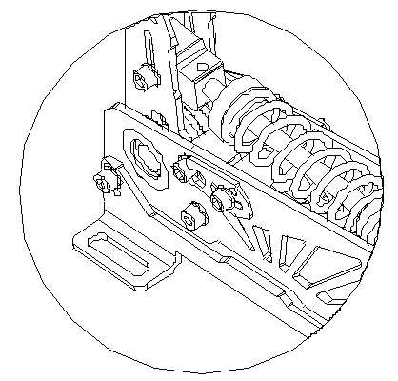
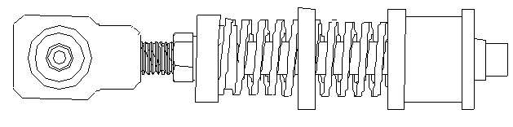
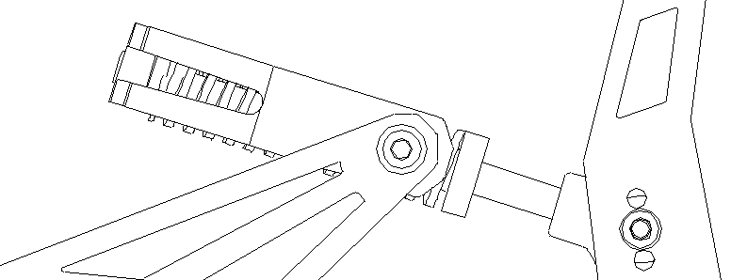
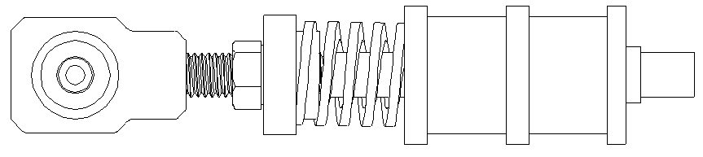
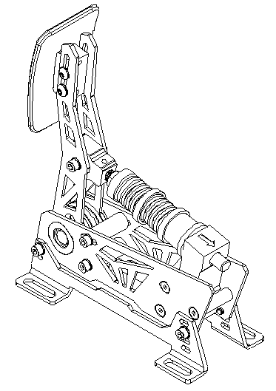
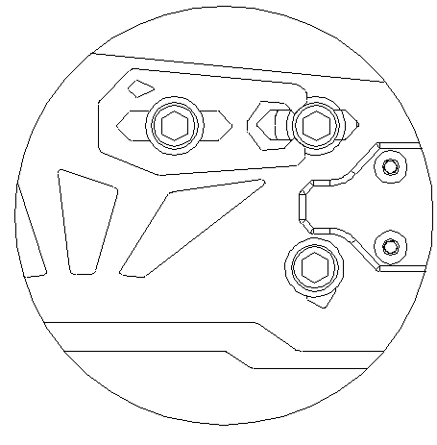
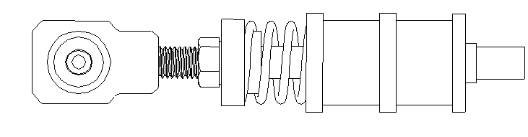
4. Adjust the Pedal travel range
5. Adjust the Brake pedal
Loosen the 2 hex bolts on the sides, adjust 2 blue bump stops to change pedal stroke
Step 1: Remove the elastomer stack
Step 2: Choose a suitable combination of springs and elastomers
Top Bump stop:
Determines the pedal travel end point
Bottom Bump stop:
Determines the pedal travel start point
max
1
min
Combinations of 3 elastomers/springs are recommended. Feel free to get creative with different combos.
max
2
Unlock a wider range of customizability with the VNM Brake Upgrade Kit. This allows you to set various stiffness levels to suit different racing disciplines and
min
Adjusting the Top Bump stop
Some possible combinations:
Step 1: Disassemble the spring assembly.
Step 2: Loosen the 4 hex bolts at the (1) & (2) positions on the sides, choose a suitable position for the blue bump stop, then tighten the bolts at the (2) position
Step 3: Move the locating pin to press against the hex bolt (2) then tighten the hex bolt (1) (Applicable with VNM Throttle and VNM Clutch).
Step 4: Reinstall the spring assembly.
Option 1: Medium initial travel, medium stiffness
Step 3: Re-install the elastomer stack
Remove the bolts on both sides then remove the spring assembly
Reinstall the stack and adjust the preload to your liking.
Option 2: Light initial travel, medium stiffness
2
1
Option 3: Low stiffness, longer travel
And many more possible combinations
Step 4: Recalibrate in the VNM Configurator

Slide 3
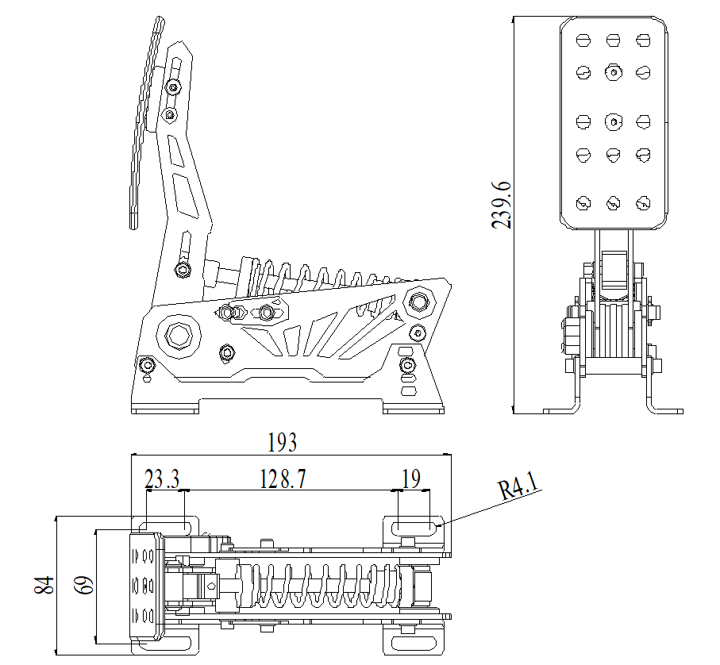
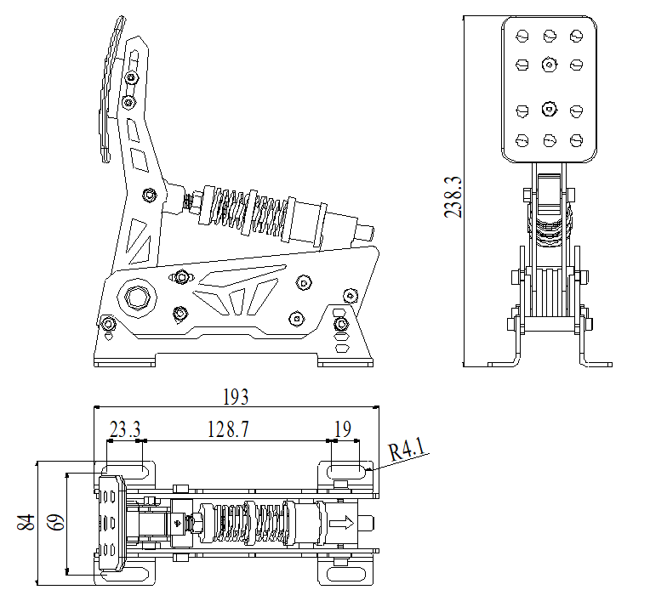

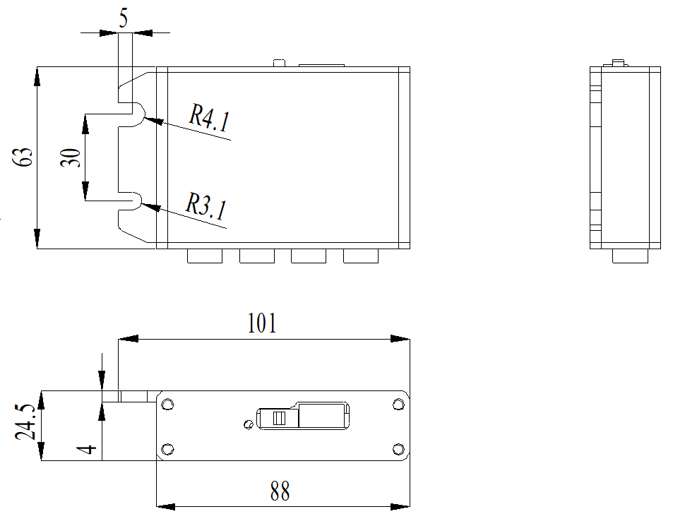
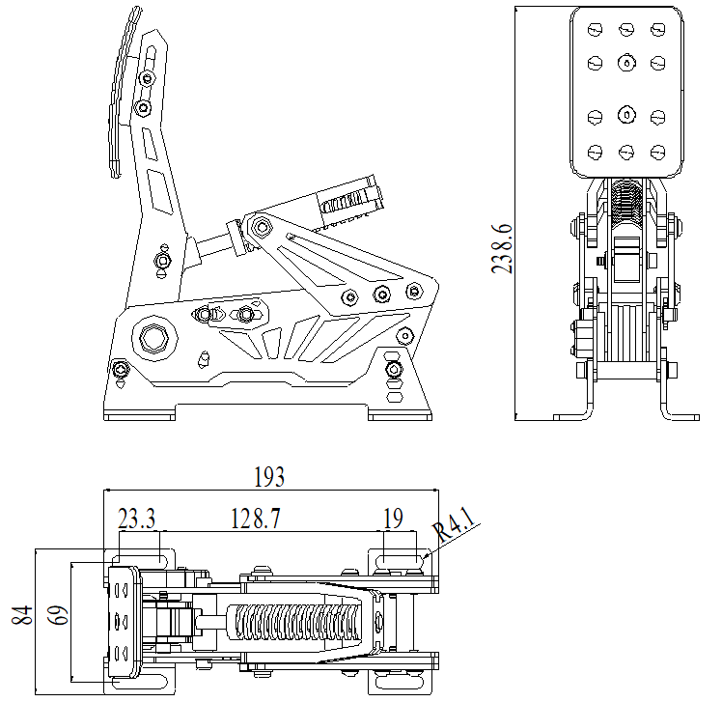
Throttle Dimensions
Brake Dimensions
Controller Box Dimensions
Clutch Dimensions

